Slide 1


SMART INDIA HACKATHON 2025
TITLE PAGE
Problem Statement ID –
Problem Statement Title-
Theme- SmartLearn
PS Category- Software
Team ID-
Team Name - TechDynamos

Slide 2
SmartLearn
Tech
Dynamos
SmartLearn : AI-powered memory booster
Proposed Solution → An interactive, gamified learning platform.
Problem Solved → Boring study methods, poor retention, exam anxiety.
Uniqueness → Concept-to-story + integrated revision tools + engaging dashboard.

Slide 3
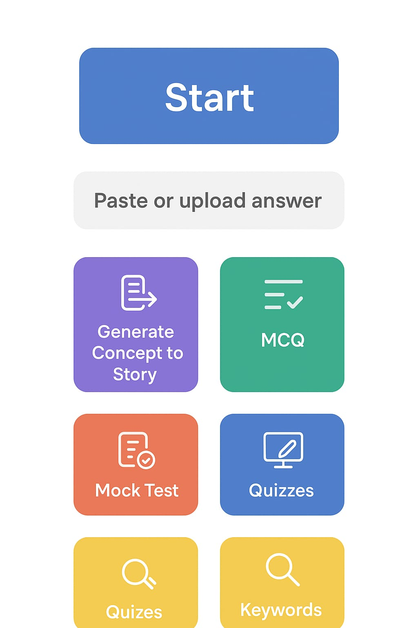
TECHNICAL APPROACH
Tech
Dynamos
Frontend (User Interface):
HTML, CSS, JavaScript – for structure, styling, and interactivity.
Backend (Server-Side):
Java (Spring Boot) – for building APIs, handling logic, and connecting to the database.
Database (Storage):
PostgreSQL – for storing user data, quizzes, flashcards, progress, etc.

Slide 4
FEASIBILITY AND VIABILITY
Tech
Dynamos
Feasibility → Technically and economically doable.
Risks → Content creation, scalability, engagement and competition.
Solutions → Start small, gamify, scale with cloud, secure data, highlight uniqueness.

Slide 5
IMPACT AND BENEFITS
Tech Dynamos
Potential Impact on the Target Audience:
Students get a fun, engaging, and effective way to study.
Teachers can use it as a support tool to explain and test concepts.
Helps learners build confidence and exam readiness.
Benefits of the solution (social, economic, environmental, etc.):
Social → Improves access to quality learning, makes education enjoyable, reduces student stress.
Economic → Low-cost, scalable platform that saves money on heavy coaching/materials.
Educational/Environmental → Digital flashcards & quizzes reduce reliance on paper notes.

Slide 6
RESEARCH AND REFERENCES
Tech Dynamos
Gagana Lingshetti ,Sarthak Pawar: AI-Powered smart Planner: Enhancing Personalized learning through Intelligent Scheduling .
Ambroise Baillifard1†,Maxime Gabella , Pamela Banta Lavenex3: Implementing Learning Principles with a personal AI Tutor : A Case Study .
Ramteja Sajja, Yusuf Sermet, Muhammed Cikmaz, David Cwiertny, Ibrahim Demir: Artificial Intelligence-Enabled Intelligent Assistant for Personalized and Adaptive Learning in Higher Education.

